Slide 1





CompuCell3D Workshop: Module 9.1: Compiling CC3D for C++ extensions
Michael Getz
Dept. of Intelligent Systems Engineering
and Biocomplexity Institute
Indiana University
Bloomington, IN 47408
USA
Thursday, August 6, 2026
Link to Compucell3D Developer manual: https://compucell3ddevelopersmanual.readthedocs.io/en/master/index.html
Hackathon Idea Sharing Documents: https://tinyurl.com/2026TeamingDoc
Please join the workshop Slack: https://tinyurl.com/2026CC3DSLACK
Workshop will be live-streamed, recorded and distributed on YouTube
Funding: NIH U24 EB028887, NSF 2120200, NSF 2000281, NSF 2303695. Previous Funding: NIH R01 GM1224241, NSF 1720625
Notes:
Post slack link repeatedly in Chat Keep links available to repost

Slide 2
9.1.pre For those following along: set up your conda environment
For Windows:
In miniconda/miniforge:
Create the environment, you may have to run this command elevated
mamba env create -f %PATHTO%/env-cc3d-2026.yaml
Make sure you have mamba for faster installation speed (conda still works without mamba, but is SLOW)
conda install -c conda-forge mamba
For Mac/Linux:
cd ~/src-cc3d
mamba env create -f environment.yaml --name cc3d_compile
Please ask me for this yaml if you need it
Windows: https://compucell3ddevelopersmanual.readthedocs.io/en/master/building_core_cc3d_cpp_code_windows.html#visual-studio-2026
Mac:
https://compucell3ddevelopersmanual.readthedocs.io/en/master/building_core_cc3d_cpp_code_mac.html#mac-osx
Linux:
https://compucell3ddevelopersmanual.readthedocs.io/en/master/building_core_cc3d_cpp_code_linux.html#linux-ubuntu

Slide 3
Module 9.1 Topics
9.1.1 – Why extend CC3D?
9.1.2 – How to compile CC3D: What is needed
9.1.3 – How to compile CC3D: git clone of CC3D
9.1.4 – How to compile CC3D: compiler
9.1.5 – How to compile CC3D: conda environment
9.1.6 – How to compile CC3D: cmake
9.1.7 – Compile the solution (Windows)

Slide 4
9.1.1 What do you gain by extending Compucell3D
Python is much slower than C++, in complex environments it can be worth rewriting your python steppables as C++ steppables
C++ allows us to interact directly with the inner most loop, allowing modifications of the energy functional on a sub-mcs frequency
Compiling and utilizing the C++ level lets you edit the copy attempt probability itself!
All the plugins used during the previous sessions are written using this same pipeline!

Slide 5
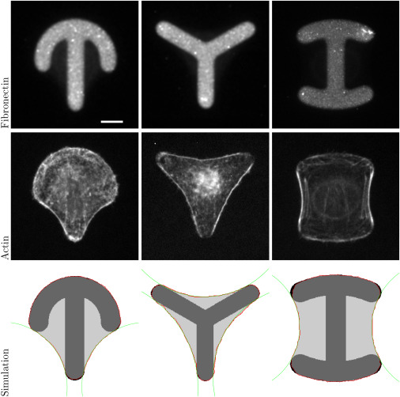
9.1.1 An example problem utilizing plug ins: Cell spreading (Albert and Schwarz 2014)
We will be creating a plug in based on part of the energy functional in Dynamics of Cell Shape and Forces on Micropatterned Substrates Predicted by a Cellular Potts Model.
We will create a cc3d module that tracks and dynamically effects the energy dependent on adhesive contacts.
Albert, P. J., & Schwarz, U. S. (2014). Dynamics of cell shape and forces on micropatterned substrates predicted by a cellular Potts model. Biophysical Journal, 106(11), 2340–2352. https://doi.org/10.1016/j.bpj.2014.04.036

Slide 6
9.1.1 Why does this need a plug in?
They define the energy functional as:
We will focus on only adding the 4th term in this exercise:
we want to add some energy applied by a finite number of adhesive sites on a cell.
How could we implement this?
Surface tension
Line tension
Actin edge fiber contribution
Adhesive energy

Slide 7
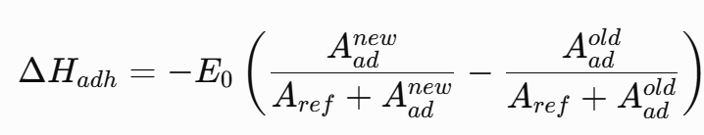
9.1.1 Why does this need a plug in?
Is the energy contribution, so our change in energy would look like:
To implement this term, We will need to modify the acceptance Evaluation (Energy Function).
We will also need to know when we have an Acceptance event (Lattice Monitors) to change the cell occupancy.
But first we need to compile CC3D

Slide 8
9.1.2 What is needed to compile cc3d?
A Copy of CC3D’s core code through Git, we will be using 4.9 in these examples (the current default path)
Miniforge/Miniconda/Aniconda
A Compiler
There are some differences in OS for this step…
We will focus on using Windows for this module, but I will cover how to set up Linux and mac environments

Slide 9
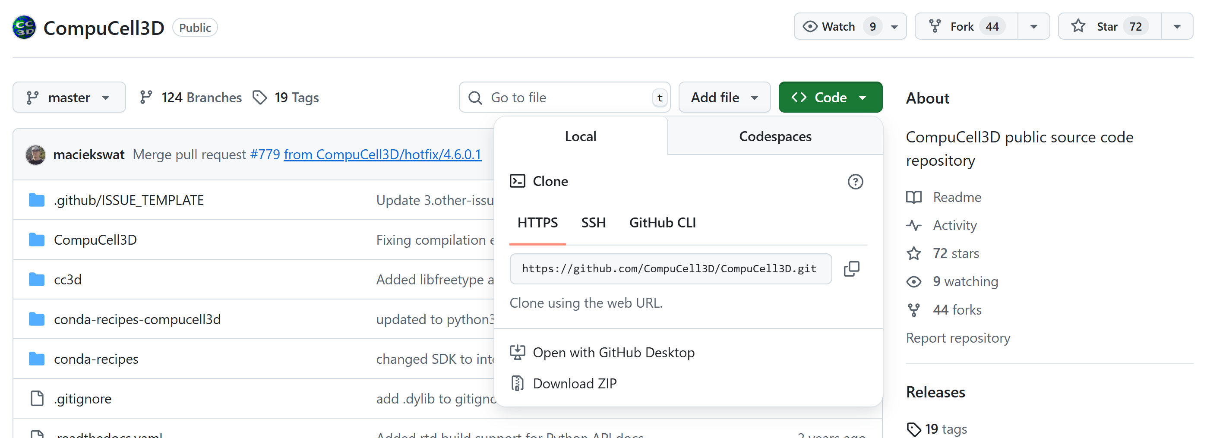
9.1.3 Getting your own copy of CC3D
For ALL OS: You need to copy the CC3D Github Repo
If you wish to contribute to core cc3d core
First fork the repo, then clone from your repository
cd SOME_PATH
git clone git@github.com:<your_github_name>/CompuCell3D.git
If not, then just clone the CC3D repository
cd SOME_PATH
git clone https://github.com/CompuCell3D/CompuCell3D.git
If you are extremely lazy you can download the zip file from github and unzip on your local pc
Remember the paths to this repo clone!

Slide 10
9.1.3 Getting your own copy of CC3D
For player and tweddit: You need to additionally copy the tweddit and player repos
cd SOME_PATH
git clone https://github.com/CompuCell3D/cc3d-player5.git
git clone https://github.com/CompuCell3D/cc3d-twedit5.git
As before, you can download the zip files from github and unzip on your local pc

Slide 11
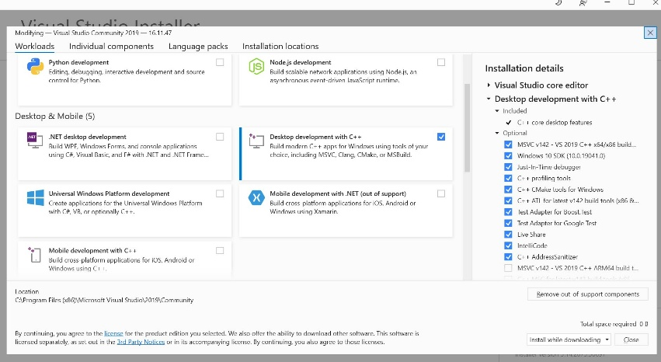
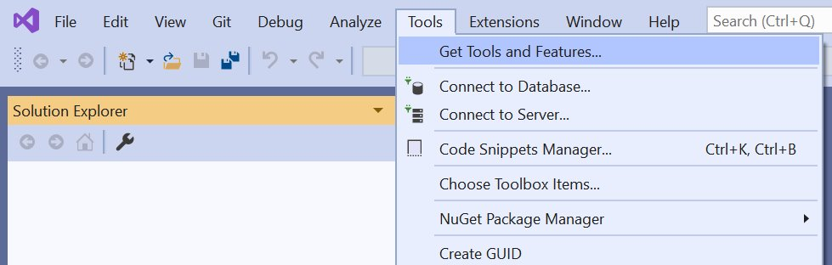
9.1.4 Getting compilers for CC3D
For Linux:
OpenGL (included)
Note: The two OpenGL options (-DOPENGL_gl_LIBRARY=/usr/lib/x86_64-linux-gnu/libGL.so and -DOPENGL_glx_LIBRARY=/usr/lib/x86_64-linux-gnu/libGLX.so) work only on Ubuntu. If you are compiling CC3D on different distribution e.g RedHat you may need to adjust those.
For Mac:
In order to compile entire CC3D code on Mac you need to install OSX core developer tools:
xcode-select --install
For Windows:
VS2026
When installing make sure Desktop development with C++ is selected. To include after installation use: Tools → Get Tools and Features.

Slide 12
9.1.5 Set up your conda environment
For Windows:
In miniconda/miniforge:
Create the environment, you may have to run this command elevated
mamba env create -f %PATHTO%/env-cc3d-2026.yaml
Make sure you have mamba for faster installation speed (conda still works without mamba, but is SLOW)
conda install -c conda-forge mamba
For Mac/Linux:
cd ~/src-cc3d
mamba env create -f environment.yaml --name cc3d_compile
Please ask me for this yaml if you need it
Windows: https://compucell3ddevelopersmanual.readthedocs.io/en/master/building_core_cc3d_cpp_code_windows.html#visual-studio-2026
Mac:
https://compucell3ddevelopersmanual.readthedocs.io/en/master/building_core_cc3d_cpp_code_mac.html#mac-osx
Linux:
https://compucell3ddevelopersmanual.readthedocs.io/en/master/building_core_cc3d_cpp_code_linux.html#linux-ubuntu

Slide 13

9.1.S1 Addional Mac information (may or may not be needed)
Install SDK into /opt. If your max uses Intel processor you will need MacOSX10.10.sdk and if your Mac uses on Apple processors (M1, M2, …) you will need MacOSX11.3.sdk. To get those SDKs visit https://github.com/phracker/MacOSX-SDKs or https://github.com/phracker/MacOSX-SDKs/releases/tag/11.3
Unpack them into /opt so that your /opt directory looks as follows:
If you happen to be on OSX and if you are using conda it is likely that after you issue the make command used to compile DeveloperZone modules you may encounter the following error:
ld: unsupported tapi file type '!tapi-tbd' in YAML file
In this case you should deactivate base conda environment by typing
conda deactivate
Into the terminal from which you are executing compilation step and trying again

Slide 14
9.1.6 Set up the environment and filepaths
Activate your mamba/conda environment
conda activate ENV_NAME
Run your cmake command : These are VERY exact. Be careful with dashes and spaces!
For Windows VS2026:
cmake -S <PATH TO CompuCell3D REPO>/CompuCell3D -B <dir to store build files> -DPython3_EXECUTABLE=%CONDA_PREFIX%\python.exe -DNO_OPENCL=ON -DBUILD_STANDALONE=OFF -G "Visual Studio 18 2026" -A x64 -DCMAKE_INSTALL_PREFIX=<dir where compiled CompuCell3D will be written to>
If using VS2015 or VS2019 change to -G "Visual Studio 14 2015 Win64" or "Visual Studio 16 2019" respectively
For Mac:
cmake -S ~/src-cc3d/CompuCell3D/CompuCell3D -B ~/src-cc3d/CompuCell3D_build -DPython3_EXECUTABLE=$CONDA_PREFIX/bin/python -DNO_OPENCL=ON -DBUILD_STANDALONE=OFF -G "Unix Makefiles" -DCMAKE_INSTALL_PREFIX=~/src-cc3d/CompuCell3D_install
For Linux:
cmake -S ~/src-cc3d/CompuCell3D/CompuCell3D -B ~/src-cc3d/CompuCell3D_build -DPython3_EXECUTABLE=$HOME/miniconda3/envs/cc3d-compile/bin/python -DNO_OPENCL=ON -DBUILD_STANDALONE=OFF -DOPENGL_gl_LIBRARY=/usr/lib/x86_64-linux-gnu/libGL.so -DOPENGL_glx_LIBRARY=/usr/lib/x86_64-linux-gnu/libGLX.so -G "Unix Makefiles" -DCMAKE_INSTALL_PREFIX=~/src-cc3d/CompuCell3D_install

Slide 15
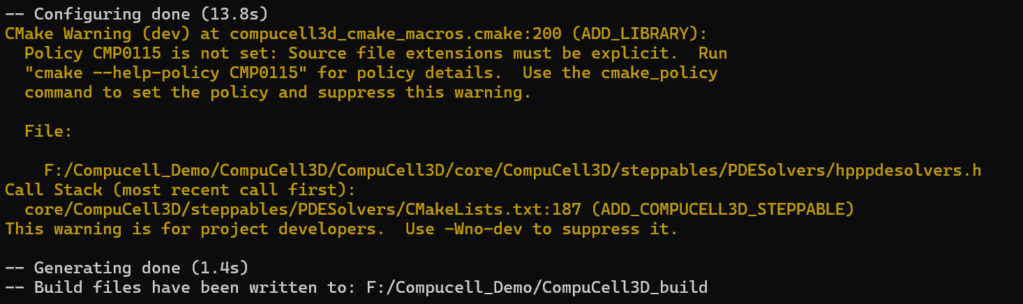
9.1.6 Cmake outcome (Windows)
My cmake input:
cmake -S %USERPROFILE%/src/CompuCell3D/CompuCell3D -B %USERPROFILE%/src/CompuCell3D_build -DPython3_EXECUTABLE=%CONDA_PREFIX%\python.exe -DNO_OPENCL=ON -DBUILD_STANDALONE=OFF -G "Visual Studio 18 2026" -A x64 -DCMAKE_INSTALL_PREFIX=%USERPROFILE%/install_projects/cc3d-compile-2026

Slide 16
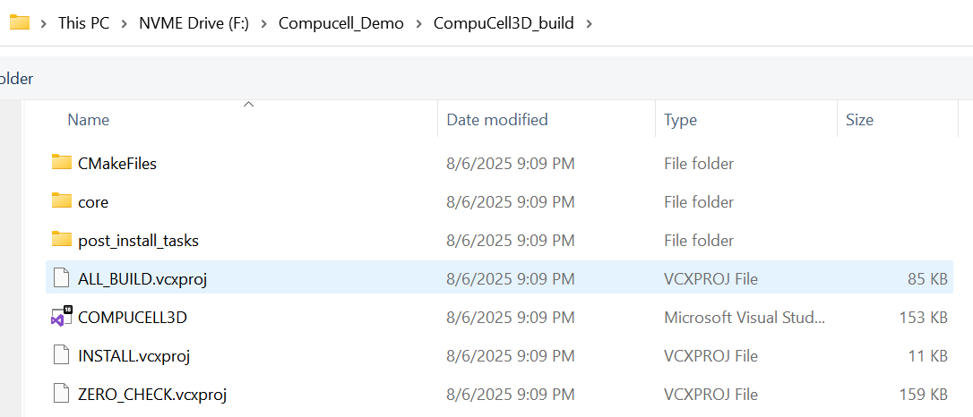
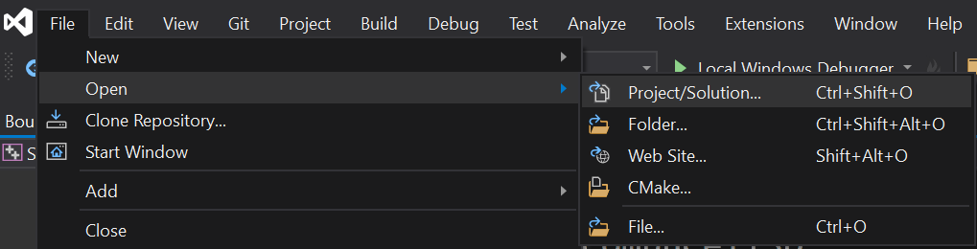
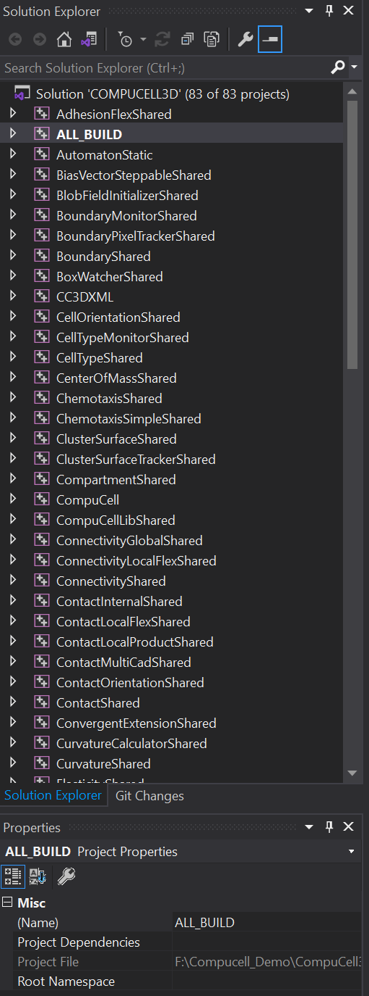
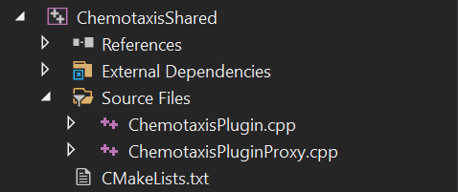
9.1.7 compile the solution (Windows)
Open Visual Studio, File→Open Project/Solution, select ALL_BUILD.vcxproj in your build folder:
Let us look at the solution explorer pane
Note: you can access source code from
this pane, e.g. chemotaxis plugin

Slide 17
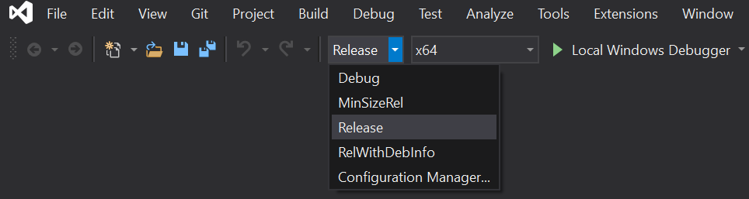
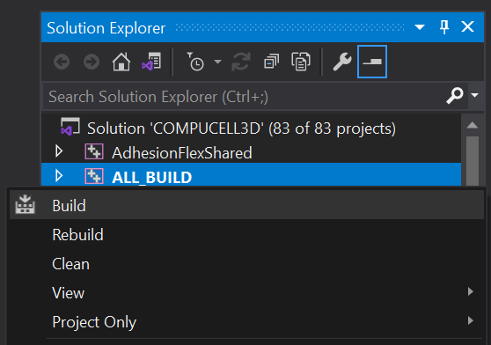
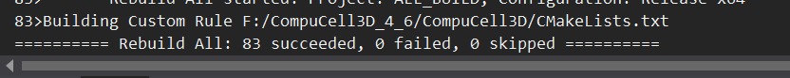
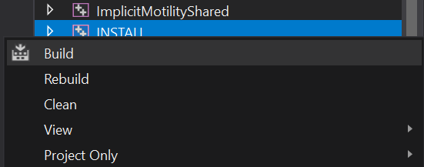
9.1.7 Compile the solution (Windows)
Set debug to Release (this is to prevent windows from becoming upset with python linkers)
Build ALL_BUILD
Note: if build fails check to make
sure Release is selected.
When complete:
Build INSTALL

Slide 18
9.1.7 Compile the solution
For other OS compilations please see: https://compucell3ddevelopersmanual.readthedocs.io/en/master/index.html

Slide 19
9.1.8 Open CC3D
Congrats! You compiled (possibly)! To open and view the GUI you must do a few extra steps
First find the location you saved the player and tweddit repos to.
Next copy those into your python miniconda/miniforge env:
xcopy "%USERPROFILE%\src\cc3d-player5\cc3d\player5" "C:\miniconda3\envs\cc3d-compile\Lib\site-packages\cc3d\player5" /E /I /Y
xcopy "%USERPROFILE%\src\cc3d-twedit5\cc3d\twedit5" "C:\miniconda3\envs\cc3d-compile\Lib\site-packages\cc3d\twedit5" /E /I /Y
You can also manually drag the folder into the env if you want.

Slide 20
9.1.8 Open CC3D
Start your env and run
python -m cc3d.player5
It should now open up!

Slide 21
Homework – Try it yourself!
Follow the steps given in the previous slides and attempt to compile and open CC3D
Note: if you are having any issues running mamba (permission errors) you will need to elevate the command (run in Administrator mode). Before activating the environment remember to return to normal permissions!

